Slide 1
Project Presentation of Industry Oriented Hands on Experience (22CS422)
On
AI Career Coach And Resume Optimization
Team details :
Aadil Verma (2210991102)
Aryan Thakur (2210991391)
Harshit Kumar (2210991635)
Vansh Thakur (2210992499)
Supervised By: Dr. Rajat Takkar
Department of Computer Science and Engineering
Chitkara University, Punjab

Slide 2
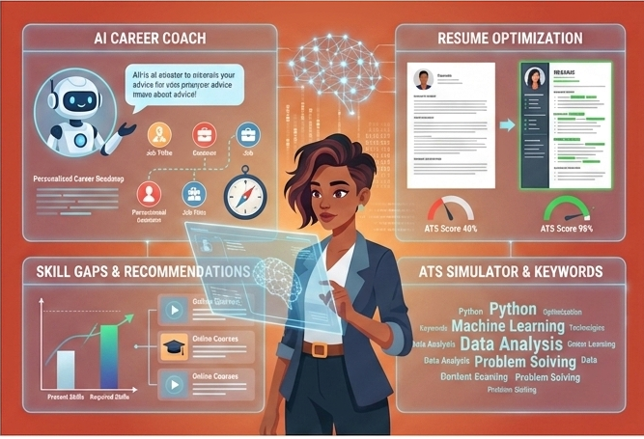
Table of Contents
Introduction
Problem Statement
Technical Details
System Design
Objectives
Project Highlights
Key Features
Conclusion
Future Scope
References/Links used
Fig.1

Slide 3

Introduction
AI Personalized Learning is an intelligent career insights platform designed to help professionals and job seekers stay ahead in their careers by analyzing real-time market trends, salary data, and skill demands
It provides users with valuable insights to make informed career decisions.
With a seamless onboarding process, secure login, and AI-powered analytics, users can explore industry growth, demand levels, and top skills required in their field. Whether you're a fresher looking for career guidance or an experienced professional aiming for growth, it empowers you with data-driven recommendations.
Fig.2

Slide 4




Problem Statement
In today’s fast-changing job market, many individuals struggle with several critical challenges:
Uncertainty in Career Planning
Lack of clear guidance on the right career path.
Resume & Interview Challenges
Difficulty in crafting strong resumes and preparing effectively for interviews.
Lack of Industry Insights
Limited access to real-time job market trends and growth opportunities.
Skill Gap Identification
No clear understanding of required skills and areas for improvement.
The Solution: AI Career Coach
Addresses these challenges by providing personalized career guidance, AI-driven resume analysis, interview preparation, and real-time industry insights, helping users make informed career decisions.
Fig.3

Slide 5
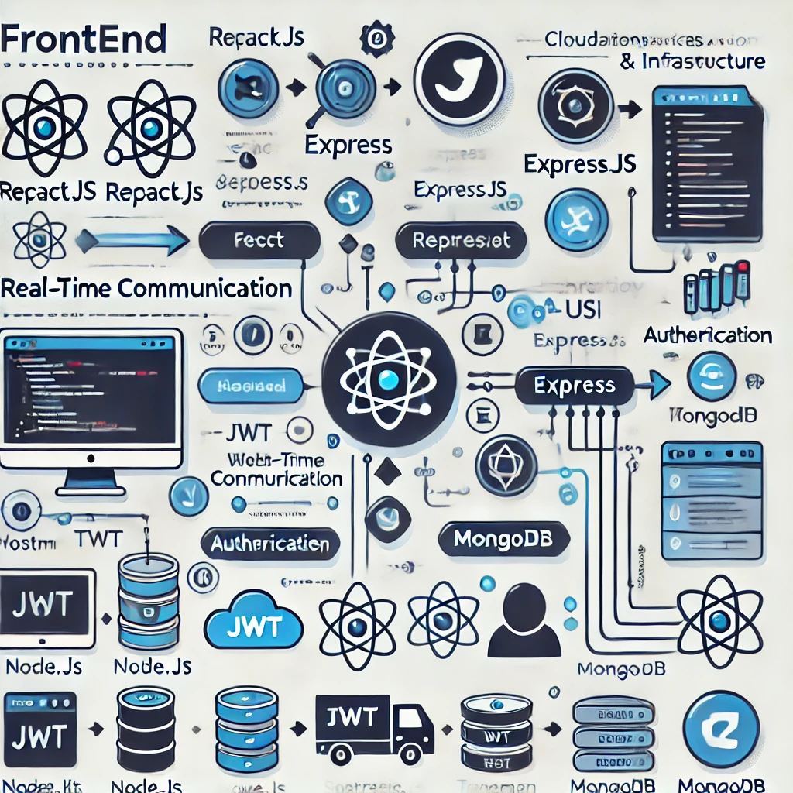
Technical Details
🔹 Frontend: Next.js, ShadCn UI, JavaScript 🔹 Backend: Node.js, Express.js, PostgreSQL 🔹 Authentication & Security: JWT (JSON Web Token) by Clerk 🔹 Cloud & Infrastructure: Hosting (Vercel), Database Service (Supabase, PostgreSQL) 🔹 ORM & Database Management: Prisma ORM 🔹 AI Integration: Gemini APIs (for AI-driven features like interview preparation and resume analysis) 🔹 Testing & Monitoring: Postman (for API testing and middleware validation)
Fig.4

Slide 6
System Design
The system design outlines the complete technical structure of the AI Career Coach, detailing how components interact and are managed across the stack.
1 Architecture
The application architecture follows a modular full-stack approach:
Frontend: Developed using Next.js with Chakra UI and shadcn/ui for responsive UI components
Backend: Built on Node.js and Express.js, handling routing, authentication, and logic
Database: PostgreSQL hosted on Supabase, managed using Prisma ORM
Authentication: Handled securely using Clerk and JWT tokens
AI Integration: Gemini APIs are used for career suggestions, resume analysis, and interview prep
2 Flow: User → Next.js → Express API → Clerk (Auth) → PostgreSQL (via Prisma) → Gemini API (AI).

Slide 7
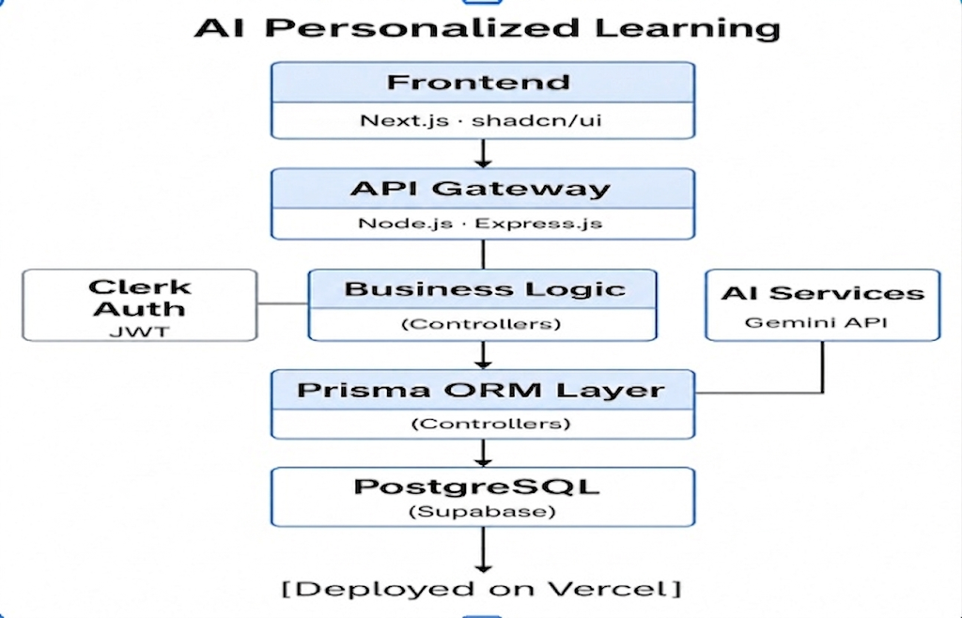
System Design
2.1 High-Level Design Diagram
Fig. 5

Slide 8
System Design
2.2 ER Diagram
User
Attributes: user_id, clerkUserId, name, email, bio, industry, timestamps
Relationships:
One user → Many Resumes
One user → Many Interviews
One user → Many Assessments
Resume
Attributes: resume_id, user_id (FK), skills, experience, education, filePath
Interview
Attributes: interview_id, user_id (FK), questions (JSON), score, feedback, date
Assessment
Attributes: assessment_id, user_id (FK), category, quizScore, improvementTips

Slide 9
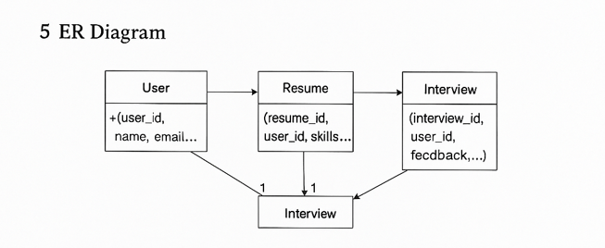
System Design
ER Diagram:
Fig. 6

Slide 10
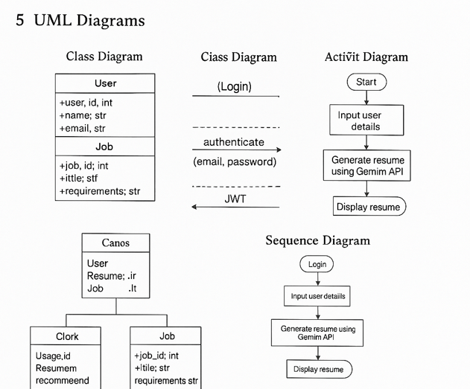
System Design
2.3 UML Diagrams
Class Diagram
User: userId, name, email, password, industry
Resume: resumeId, userId, skills, experience
Job: jobId, title, description, company
Interview: interviewId, userId, score, feedback
Sequence Diagram – Login Flow
User opens login page
Sends credentials to /api/auth/login
Server validates and returns JWT + Clerk session
User redirected to dashboard with session token
Activity Diagram – Resume Generation Flow
User uploads/responses input
Data sent to backend
Gemini API processes request
Response saved in database
Resume preview/downloaded
Fig. 7

Slide 11
Objectives
Objectives
Generate AI-Powered Career Documents: Create personalized and optimized resumes and cover letters using advanced AI models.
Provide Smart Job Recommendations: Suggest suitable job opportunities aligned with the user’s skills, experience, and career goals.
Enhance Interview Preparation: Conduct interactive mock interviews and deliver AI-driven feedback with potential Q&A.
Deliver Market Insights: Offer real-time insights into job trends, in-demand skills, and salary benchmarks across industries.
Track Career Progress: Maintain a comprehensive history of job applications, interview feedback, and career growth metrics.

Slide 12
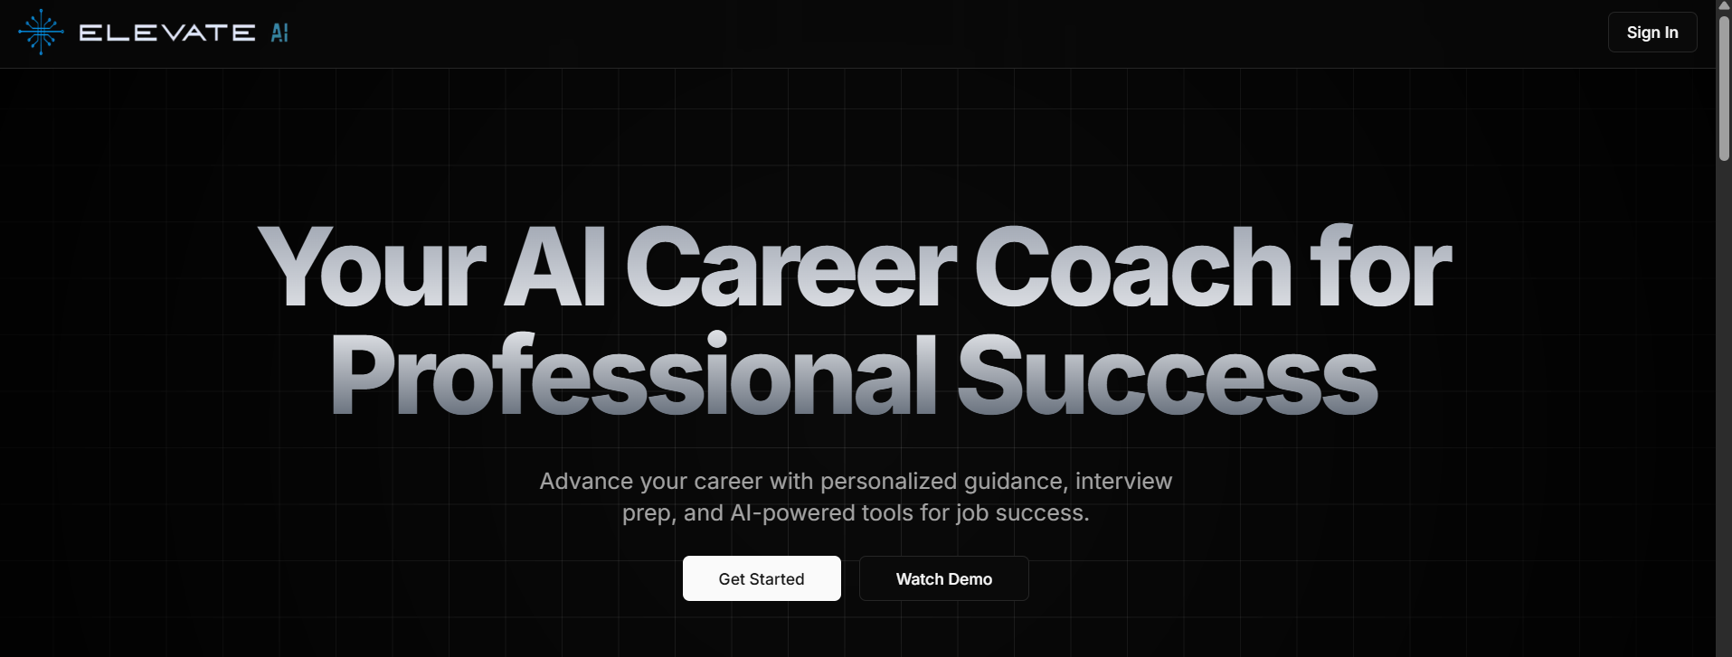
HomePage:
Fig. 8
The Landing Page is the AI Career Coach platform's first impression, designed for engagement. The hero section features a strong headline, subheading, and CTAs for sign-ups, complemented by a career growth image. Four key features are highlighted: AI career guidance, interview prep, industry insights, and smart resume creation. Credibility is built with engagement stats (e.g., 50+ industries, 95% success rate). A smooth user experience is ensured by the top navigation bar.

Slide 13
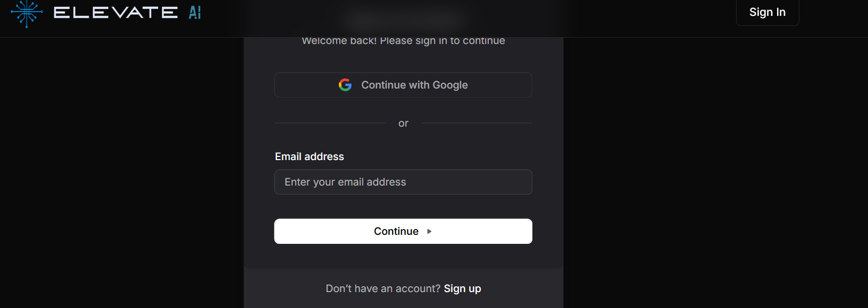
User Login Page:
Fig. 8
The User Login Page offers secure authentication via email/password or "Sign in with Google" for a quick, private experience. Form validation, Clerk authentication, and JWT secure sessions and enhance user management with a clean, user-friendly design.

Slide 14
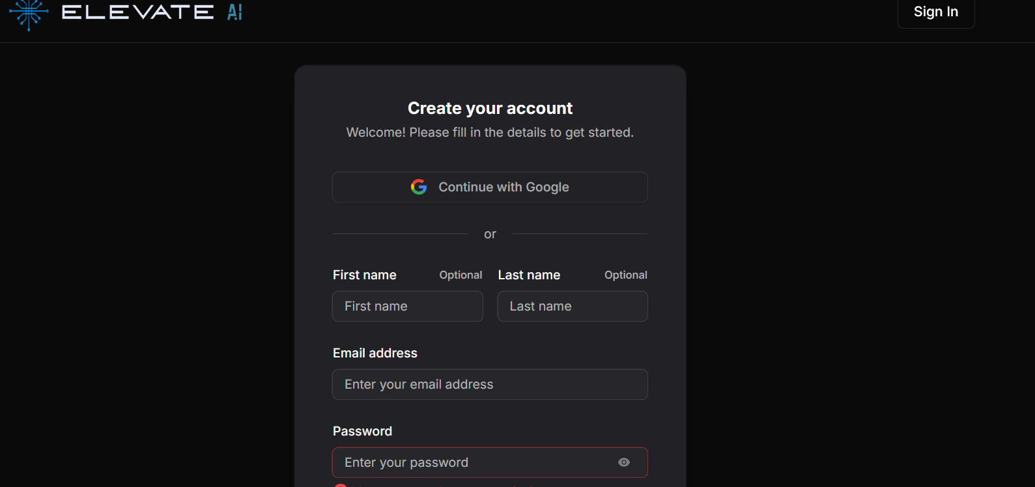
User Signup:
The User Sign-Up Page allows new users to register by providing their first name, last name, email, and password. It also includes a "Sign Up with Google" option for quick authentication. The page ensures data validation to prevent errors and enforces secure password storage to protect user credentials. By offering both manual and Google-based registration, the page enhances user experience and accessibility, making the onboarding process smooth and efficient.

Slide 15
Key Features
🚀 User Authentication – Sign up & log in via email/password or Google.
🔐 Two-Factor Authentication – Enhances security for user accounts.
📝 User Onboarding – Collects industry, skills, and experience details.
📊 Industry Insights – Displays market trends, demand level, and top skills.
💰 Salary Analytics – Provides salary ranges based on job roles.
🔎 Growth Tools – Personalized recommendations for career advancement.
🔄 Real-Time Updates – Ensures fresh data for industry insights.
🎨 Dark UI Theme – Modern and professional user interface.
📱 Responsive Design – Works across desktop and mobile devices.

Slide 16
Future Scope
Future Scope of AI Personalized Learning
As part of AI Personalized Learning continuous evolution, we aim to enhance the platform with cutting-edge features that improve user experience, security, and efficiency.
Upcoming Features
🎤 AI Mock Interviews & Feedback
Simulated job interviews with real-time AI evaluation.
Instant feedback on communication, technical skills, and confidence level.
🔐 AI Resume Builder & Skill Verification Effortlessly create professional resumes backed by verified credentials. • Provides secure, verifiable skill certificates for recruiters • Enhances trust and reduces manual validation effort
💼 AI Cover Letter & Job Matching Generate personalized cover letters and discover job/internship opportunities tailored to your profile. • AI-curated job suggestions • Seamless applications with partnered employers • Boost your chances with role-optimized cover letters

Slide 17
Conclusion
AI Personalized Learning serves as a powerful, data-driven platform that bridges the gap between career uncertainty and informed decision-making. By combining advanced AI technologies with real-time market insights, it empowers users to identify skill gaps, explore career opportunities, and enhance their professional growth effectively.
The platform not only simplifies resume building and interview preparation but also provides personalized recommendations tailored to individual goals. With its scalable architecture, secure authentication, and user-friendly design, it ensures a seamless and reliable experience.
As the job market continues to evolve, AI Personalized Learning has the potential to become an essential tool for students, job seekers, and professionals—guiding them toward smarter career choices and long-term success.

Slide 18
References:
To develop and integrate advanced features in AI Carrier Coach , we referred to the following technologies, tools, and resources:
Authentication & Security 🛡 Clerk Authentication (User Management) – www.clerk.dev
Backend & Database
🛠 Node.js & Express.js for API development – nodejs.org | expressjs.com 🗄 PostgreSQL & Neon for database storage – www.postgresql.org | neon.tech 🔧 Prisma ORM for database management – www.prisma.io
AI & Industry Insights
🤖 Gemini APIs for AI-powered career analysis – ai.google.dev 📊 Industry Trends & Insights – LinkedIn Economic Graph | Glassdoor Research
Frontend Development
💻 Next.js Documentation – nextjs.org 🎨 ShadCn UI for UI Components – chakra-ui.com
Testing & Monitoring
🧪 Postman for API testing & middleware validation – www.postman.com 📈 Log Monitoring & Performance Analysis – Datadog | Sentry

Slide 19
THANK YOU

